Slide 1

Data Visualisation -Empowering Business with Effective Insights
Task 4
Communicating Insights and Analysis
09 December 2025

Slide 2
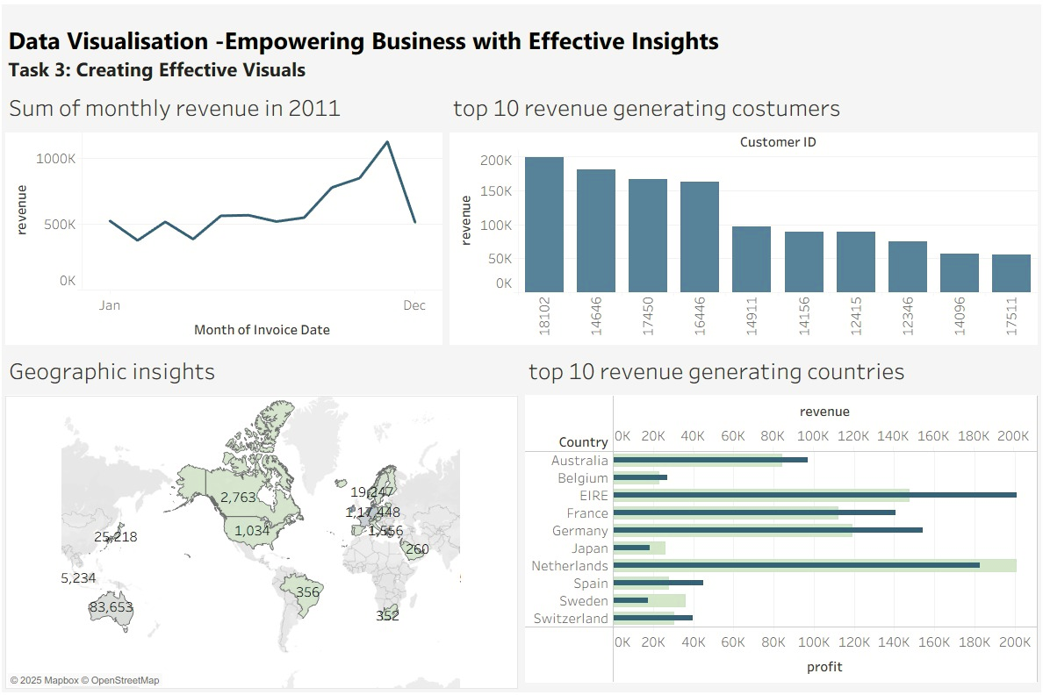
Dashboard Preview

Slide 3
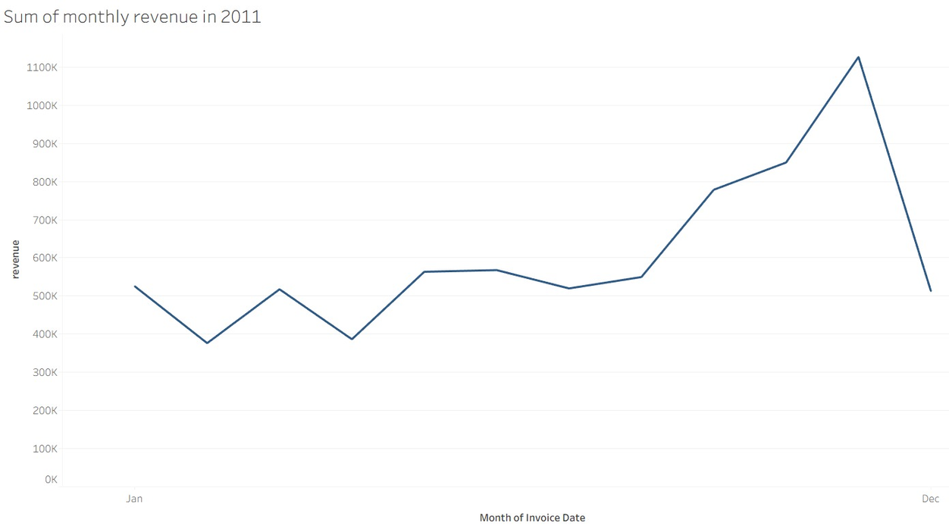
Revenue trend
The first eight months show steady revenue, averaging about $685K. Starting in September, sales rise sharply and peak at $1.5M in November. December data is incomplete, but it’s clear that the last four months of the year are strongly seasonal

Slide 4
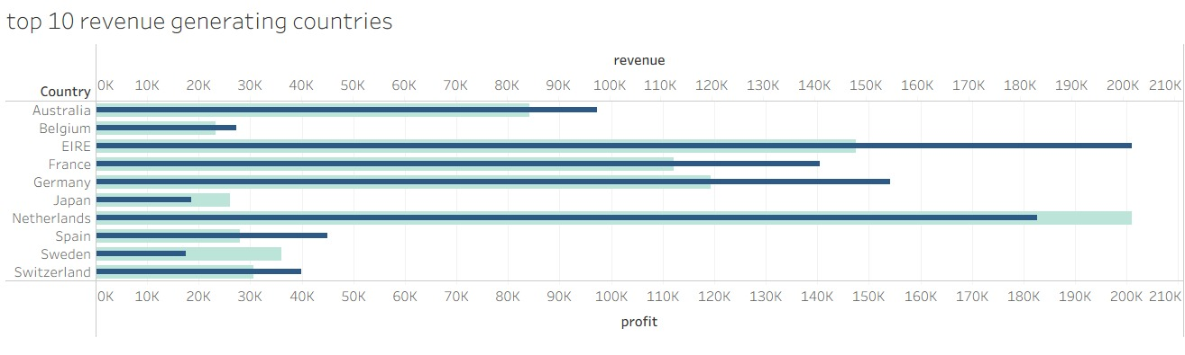
Rankings
The second chart shows the top ten growth-potential countries, excluding the UK. The Netherlands, Ireland, Germany, and France show strong unit sales and revenue. Focusing on these markets would help capture more demand.

Slide 5
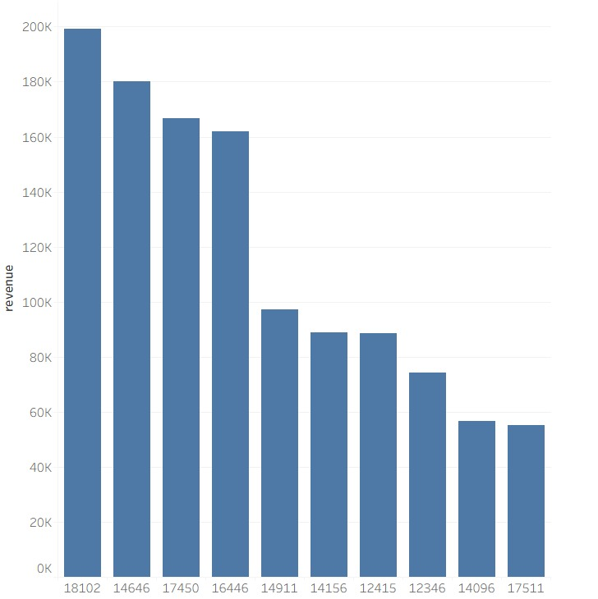
Top 10 customers
The third analysis looks at the customers who purchased the most. The differences among the top 10 are small. The highest-spending customer only purchased 17% more than the second. This suggests the business isn’t dependent on a small group of buyers and that customer bargaining power is limited.

Slide 6
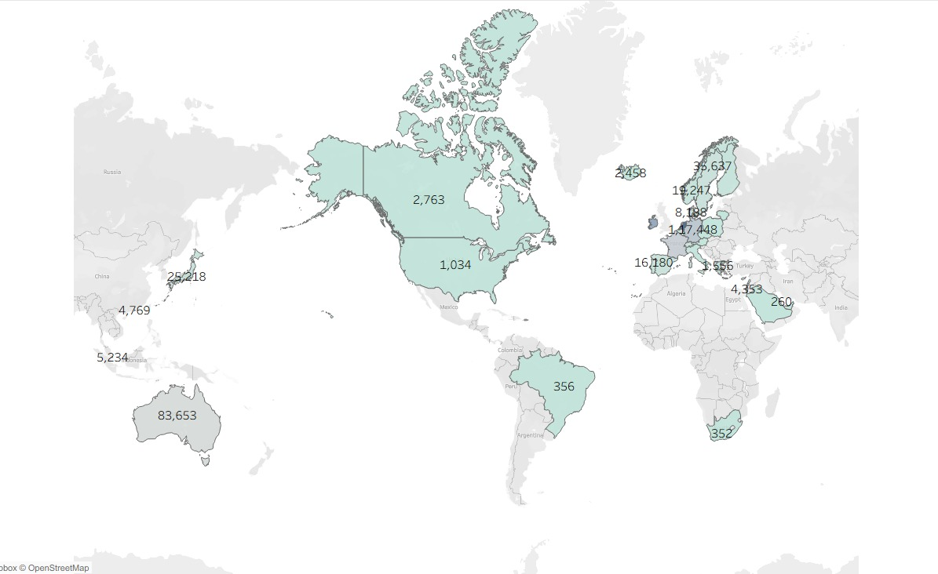
Geographic performance
The map highlights high-revenue regions such as the Netherlands, Ireland, Germany, France, and Australia. Demand is low in Africa, Asia, Russia, and parts of the Americas. A targeted strategy in these areas could help increase sales and profitability.

Slide 7
Thank you

